Slide 1


Добре дошли в [име на клуба]
Ориентация за нови членове
1
Notes:
Speaker Noes:
Some things to keep in mind: Use names, Smile, keep it informal. Don’t read bullets and feel free to change photos shown, to photos of your club.
“Welcome, we’re really glad you’re here.
This will be a quick conversation to help you feel comfortable, understand how our club works and figure out your first step as a Lion.”

Slide 2
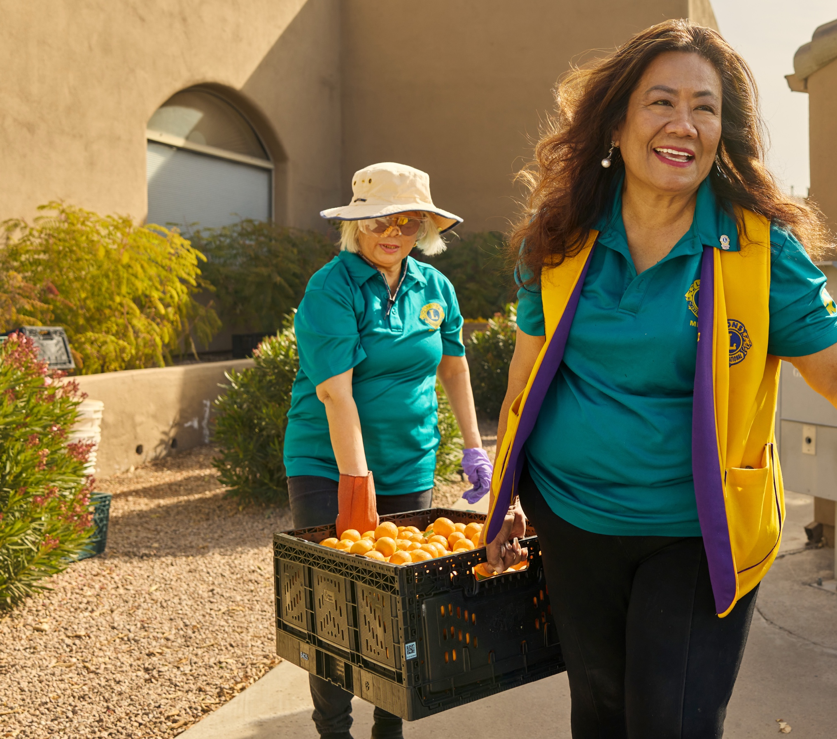

Да разберем:
Какво прави клуба ни уникален
Какво значи да си Lion
Как можеш да участваш
Твоята следваща стъпка
2
Notes:
Speaker Notes
“This is meant to be simple and helpful — not overwhelming.
We’ll talk about who we are, how things work and how you can jump in.”

Slide 3

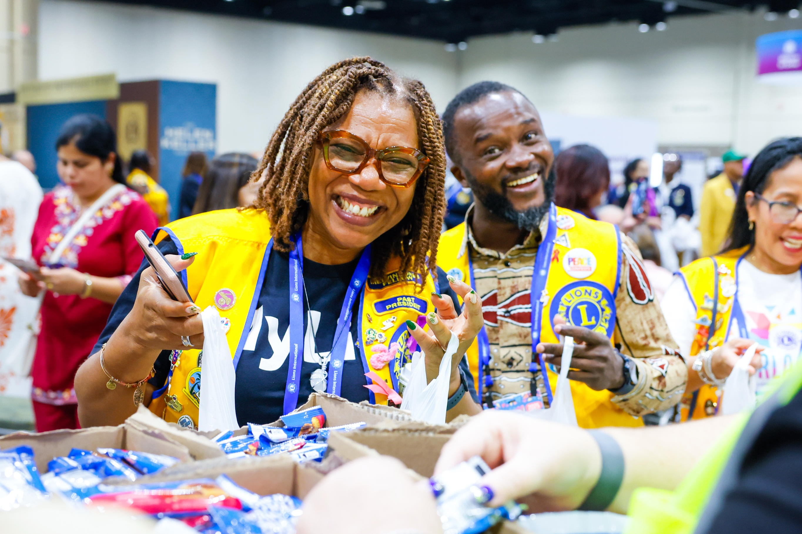
За нашия клуб
Година на създаване: [Insert]
Брой членове: [Insert]
С какво сме известни:
  [Insert 1-2 things]
  [Insert 1-2 things]
3
Notes:
Speaker Notes
“Every Lions club is a little different, so this is what makes our club unique.
[Share one short story or example.]
That’s really the best way to understand who we are.”

Slide 4
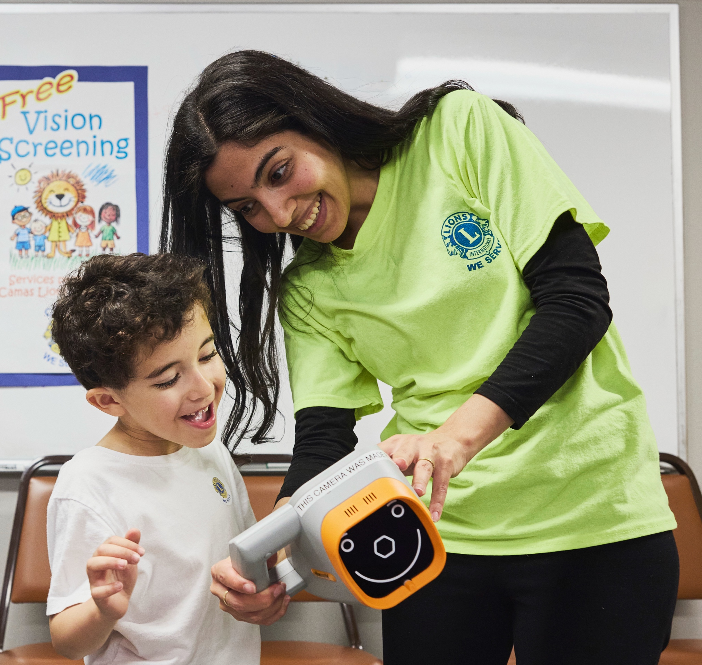


Как Служим
[Въведи вид дейност]
[Insert Service Project]
[Insert Service Project]
[Insert Service Project]
Следващ/и възможност/и: [Insert]
4
Notes:
Speaker Notes
“This is what we actually do in our community.
The best way to get started is to join a service project — it’s where you’ll meet people and see the impact right away.”

Slide 5
Световна Мрежа
1.4+
48000+
Милиона членове
Клуба
В над 200+ страни по цял свят
5
Notes:
Speaker Notes
“While our club is local, you’re now part of something much bigger.
Lions are serving all over the world — and you’re part of that same mission.”

Slide 6
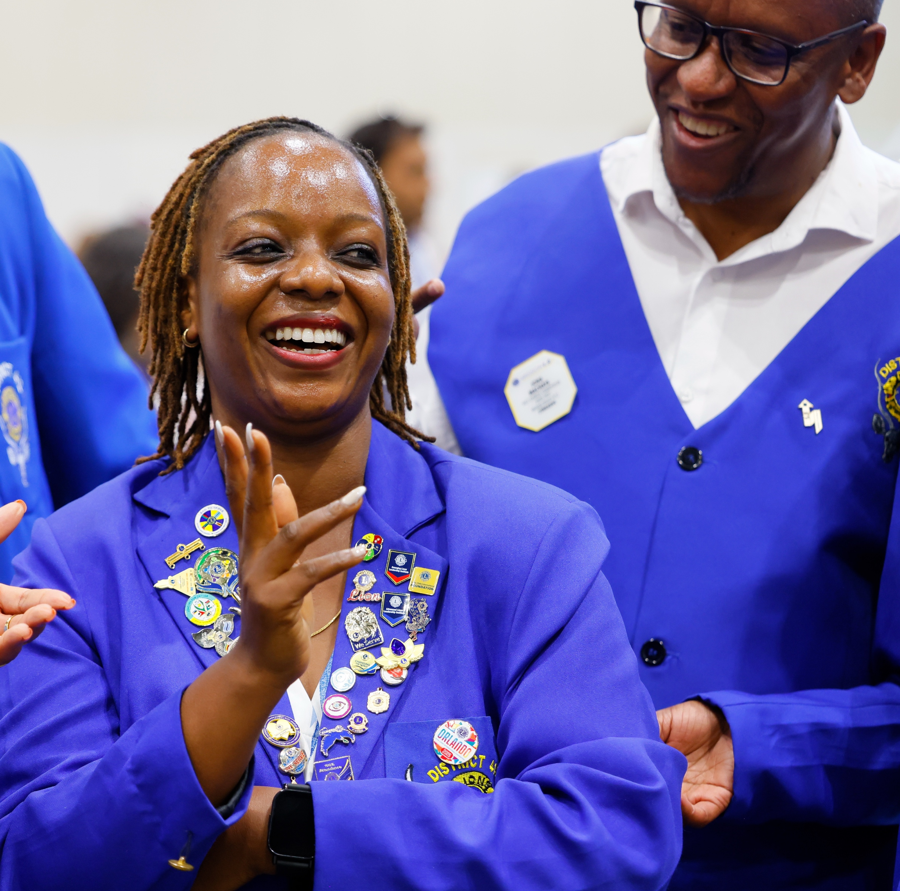


Ти си част от нещо по-голямо
Локални дейности. Глобален ефект. Истинска промяна.
6
Notes:
Speaker Notes
“What you do here locally connects to something global.
That’s what makes being a Lion really meaningful — you’re part of a much bigger impact.”

Slide 7

Всеки клуб е различен
Проекти, традиции и култура може да изглеждат различни за отделните клубове.
Гъвкавостта е част от това, което прави Lions силни.
7
Notes:
Speaker Notes
“There’s no single ‘right way’ to be a Lions club.
Each club is shaped by its members and community — and that flexibility is actually one of our strengths.”

Slide 8
Как да участваш
Участвай в срещите и опознай членовете
Включи се в дейност/проект и виж резултата от твоето участие
Помогни с малка роля или с някоя от работните групи
Сподели своите интереси и идеи
Покани някой да служи заедно с теб
8
Notes:
Speaker Notes
“There’s no expectation to do everything right away.
The best approach is to start small — attend a meeting, join a project and get to know people.
As you get more comfortable, you’ll naturally find your place.”
“Which of these feels like the easiest first step for you?”

Slide 9
Каква малка цел би искал/а да си поставиш?
9
Notes:
Speaker Notes
“Many new members find it helpful to set one simple goal.
It could be attending meetings regularly, joining one service project or just getting to know a few members.”
“Let’s pick one together.”
[Pause and confirm]

Slide 10
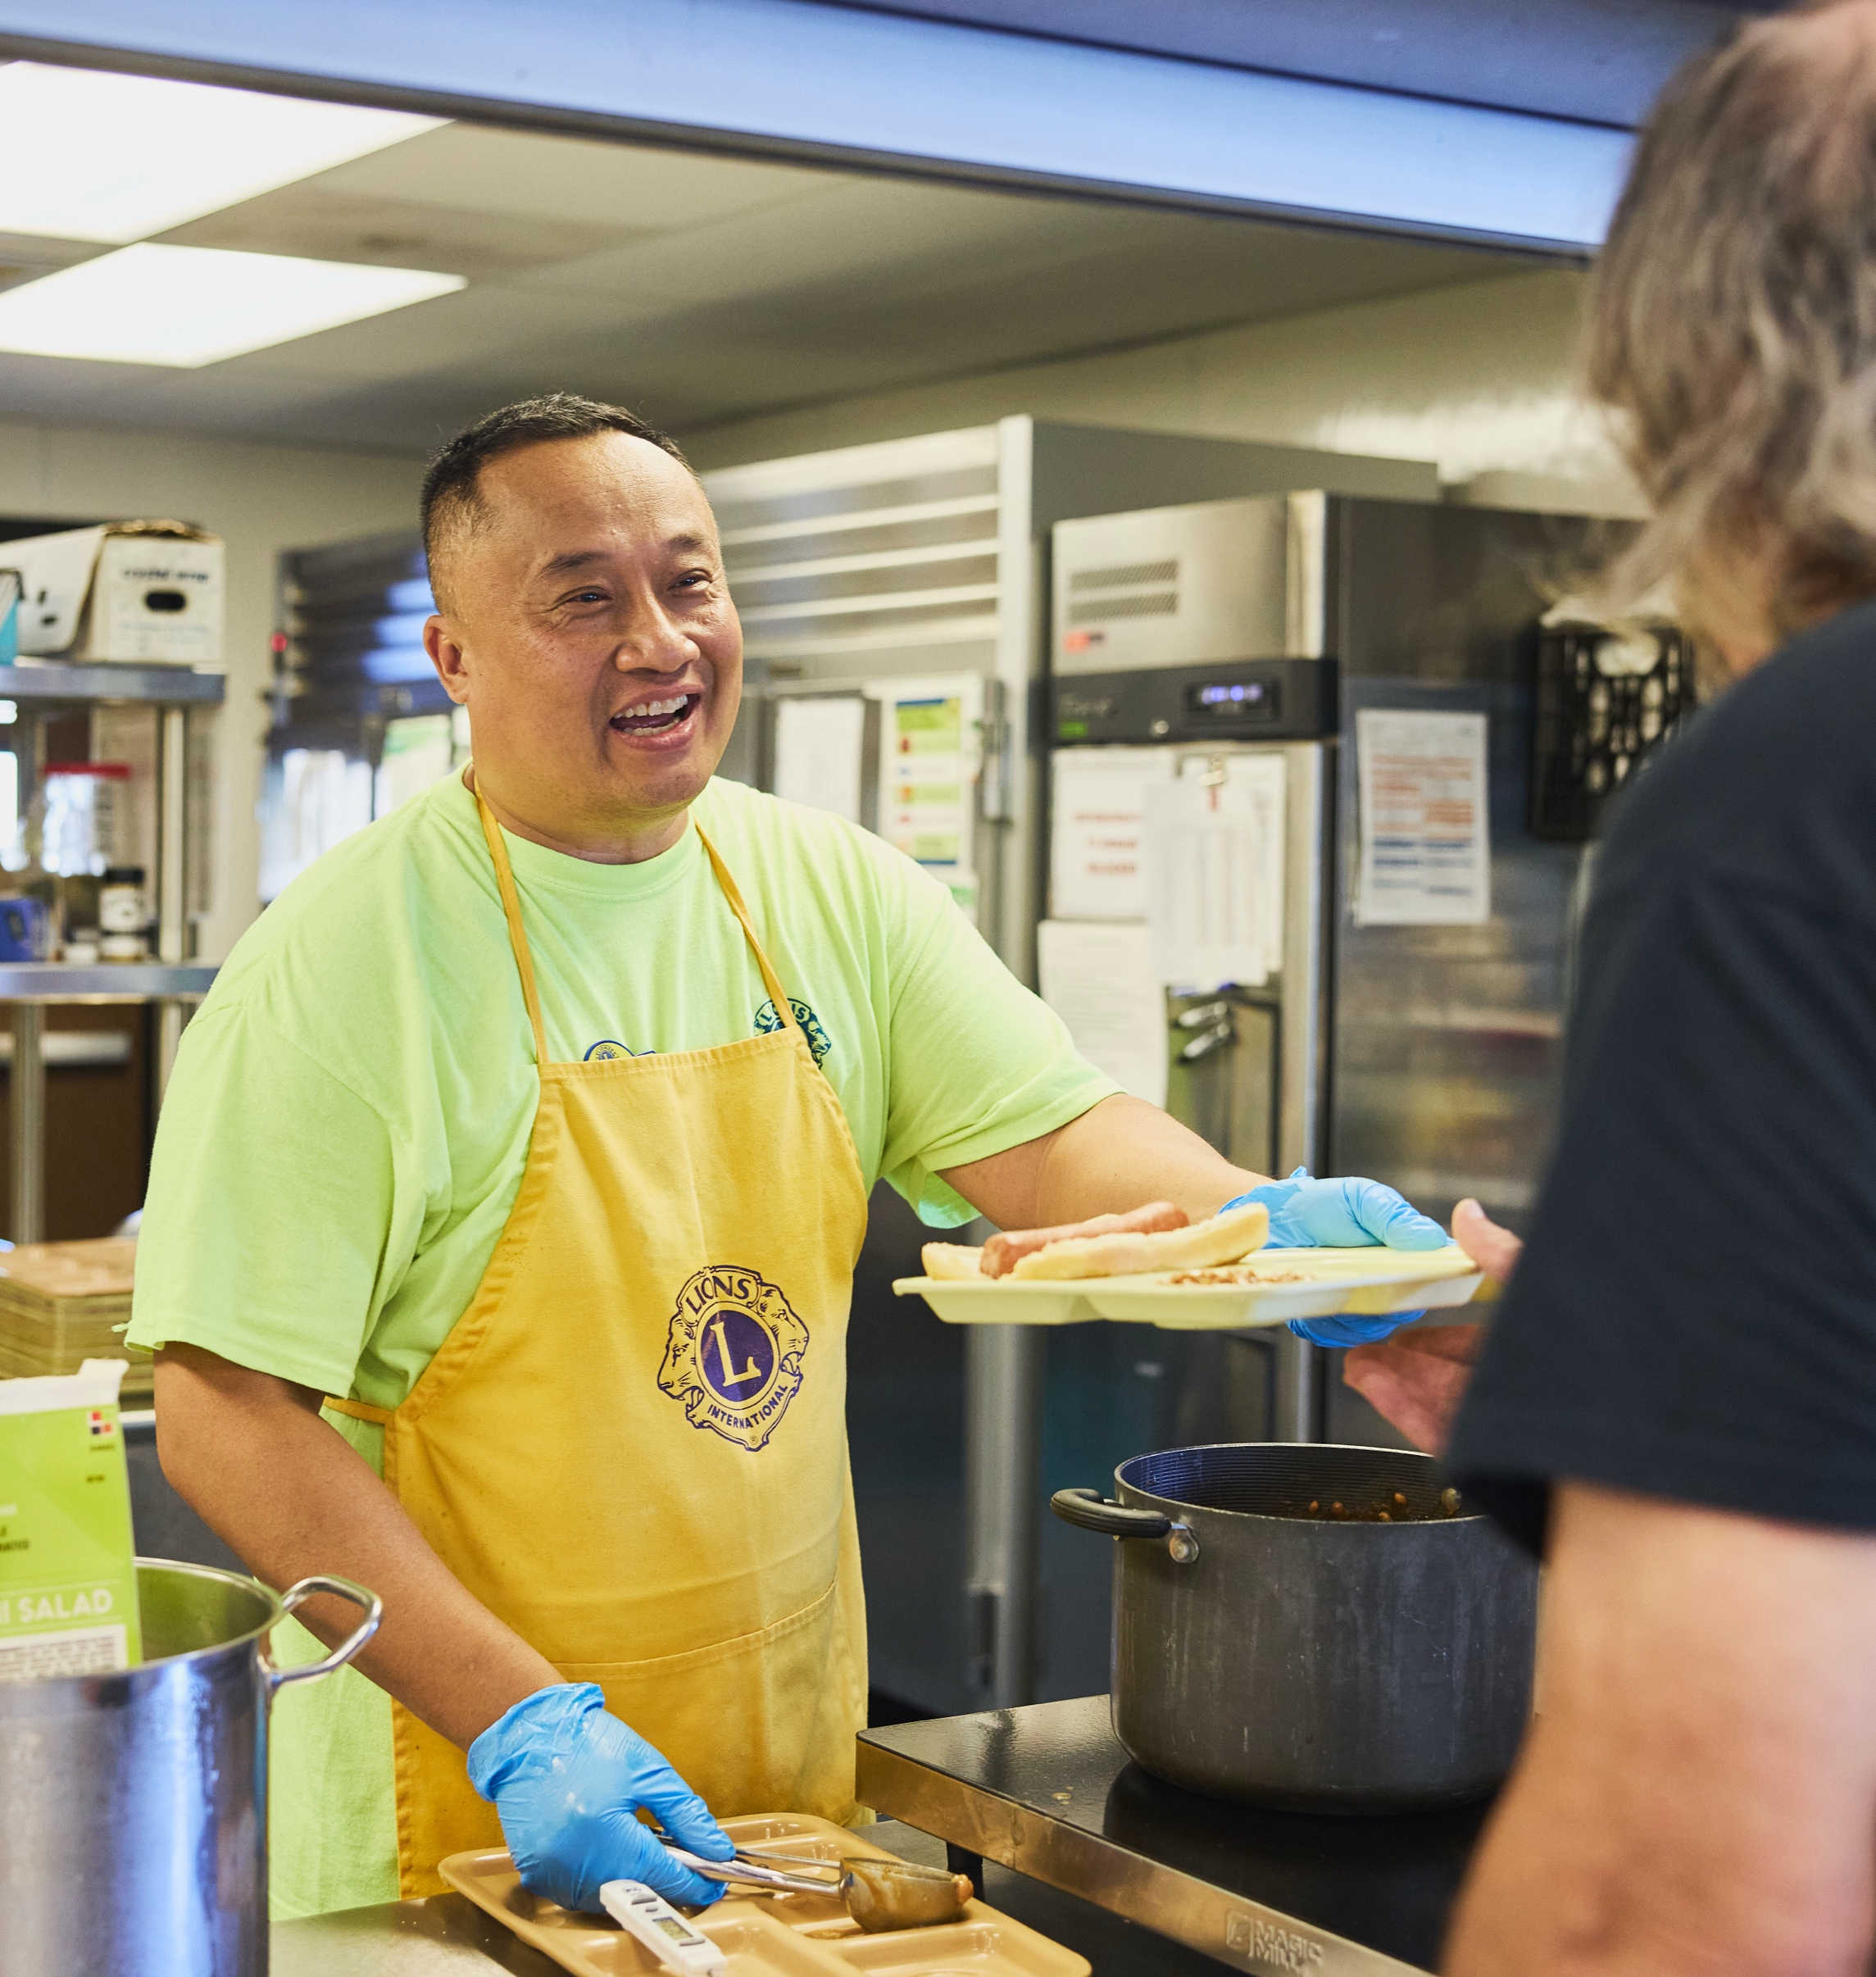
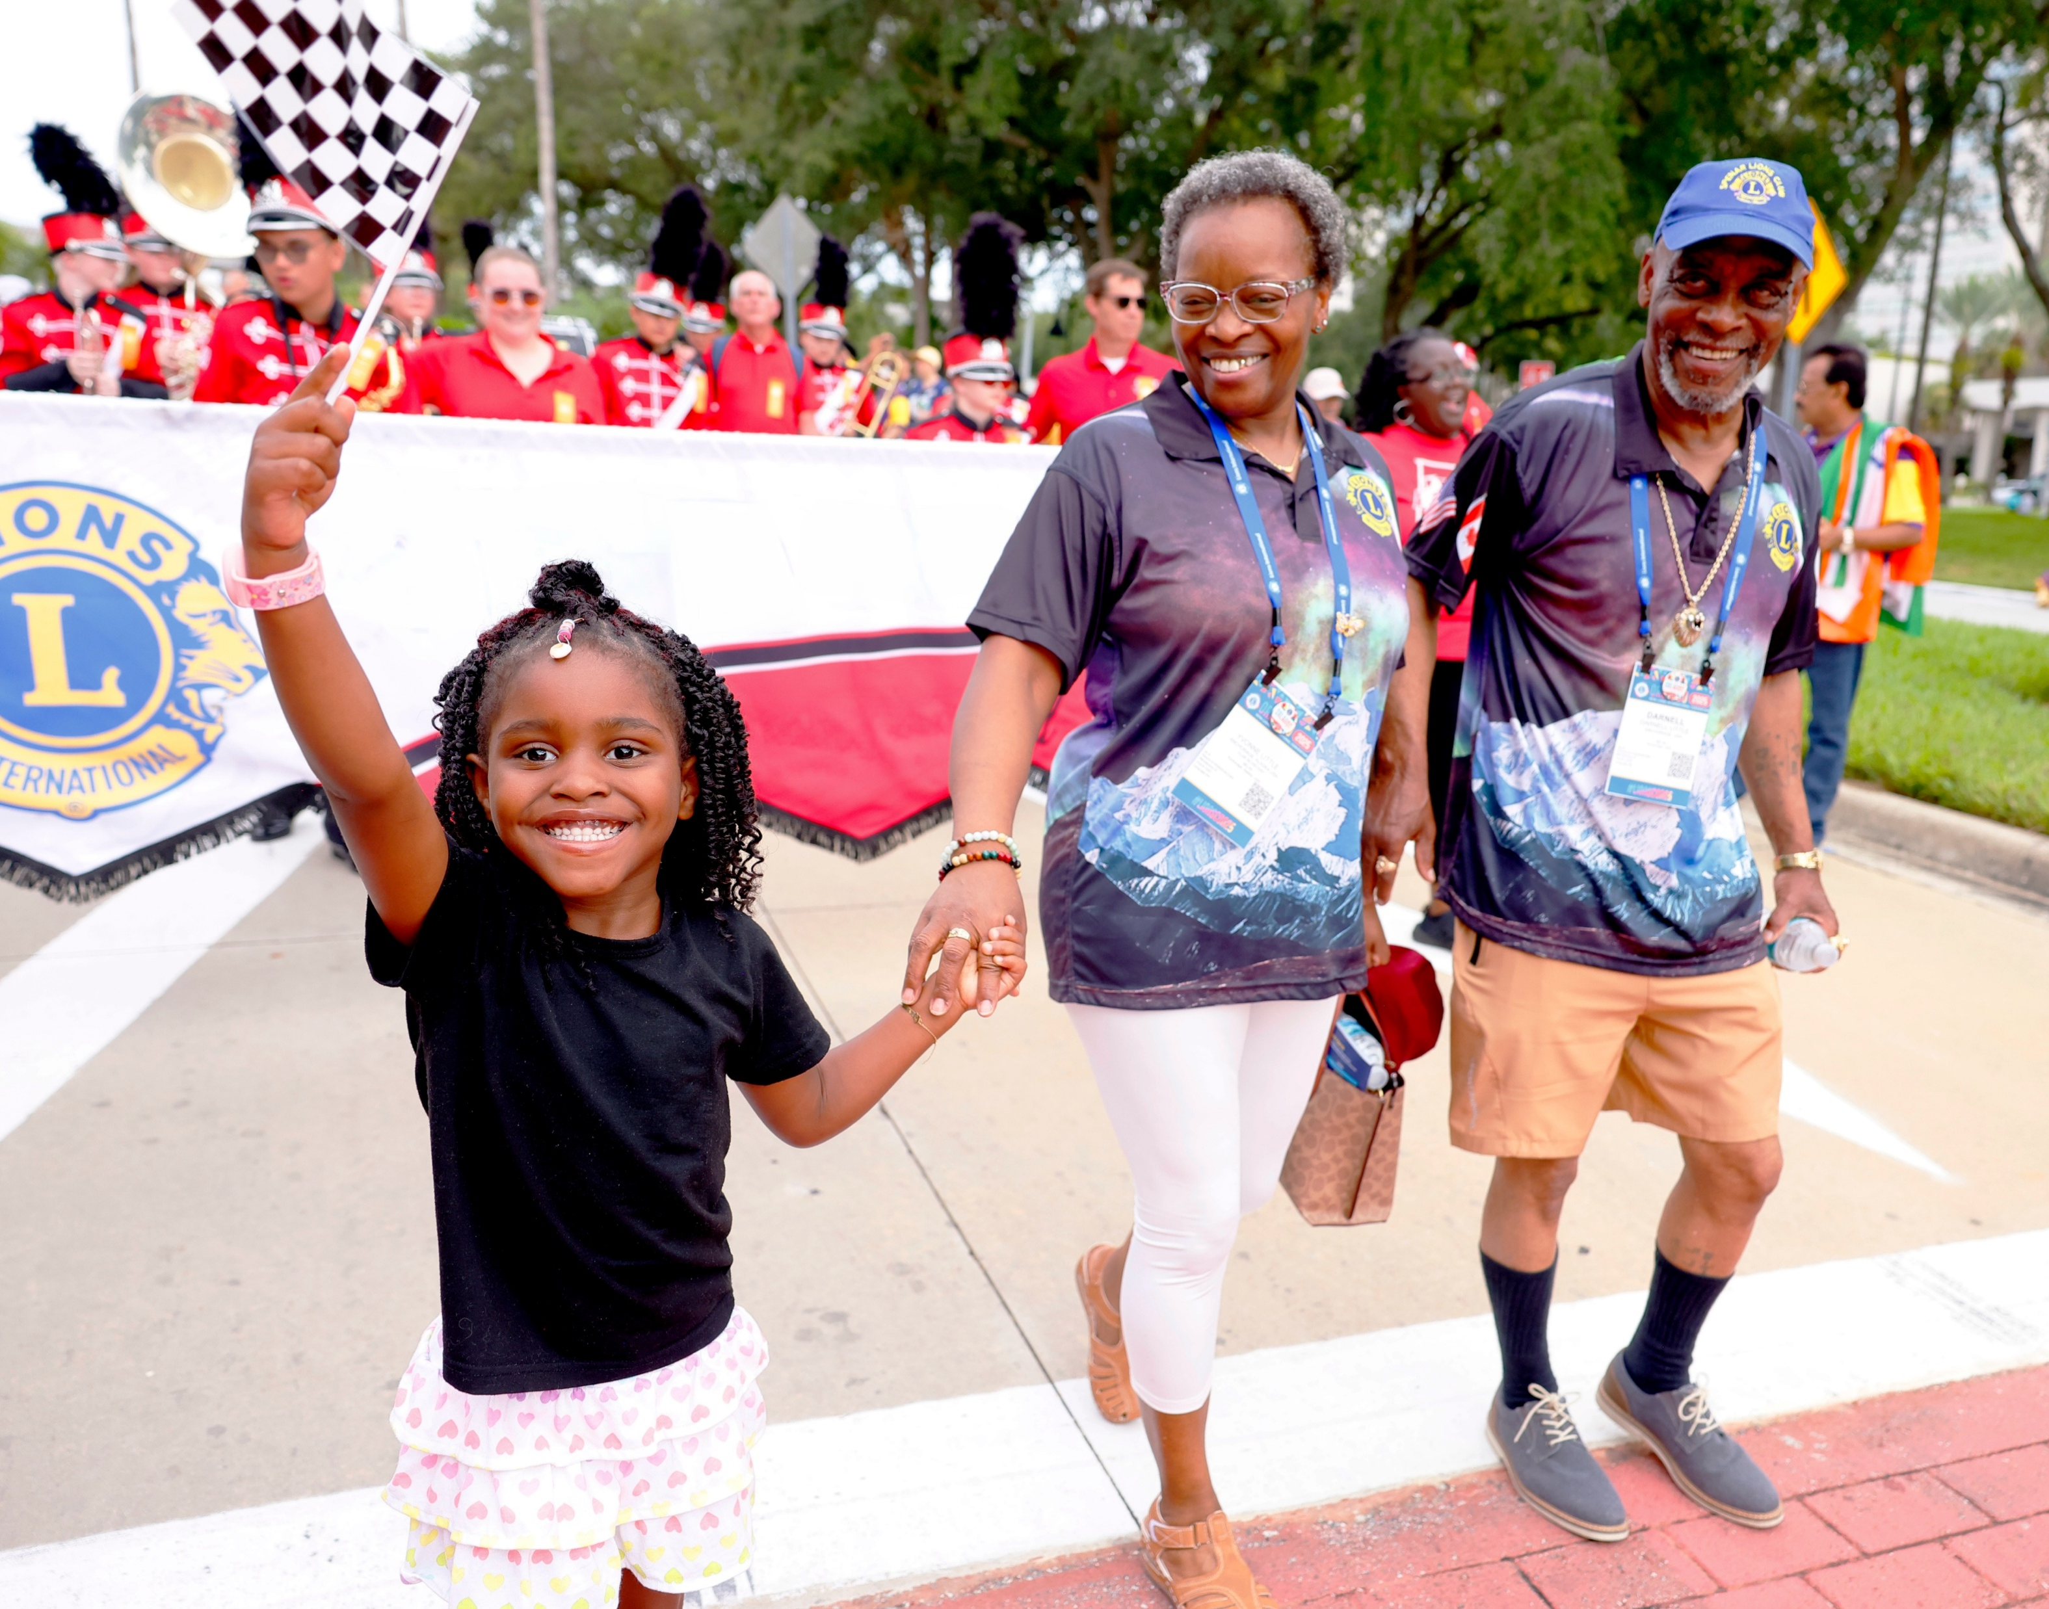
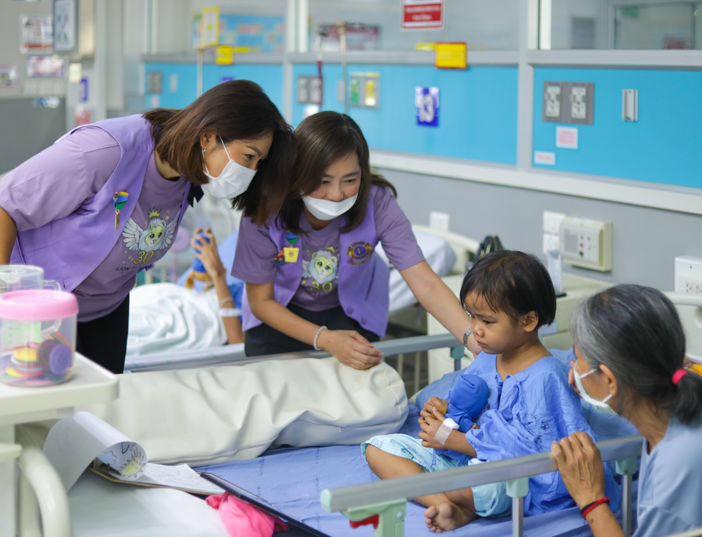
Това е твоят клуб
Ти помагаш да се оформя
Ти каниш други да служите заедно
Ти съграждаш общността
10
Notes:
Speaker Notes
“One thing that’s unique about being a Lion is that you’re not just participating — you’re helping shape the club.
Anyone can volunteer occasionally, but as a member, you help decide what we do and who joins us.
Over time, you’ll naturally invite others to serve with you. That’s how clubs grow.
But there’s no pressure right away — that comes naturally.”

Slide 11

Как се плащат таксите
Годишните членски вноски помагат за функционирането на:
КЛУБА
ДИСТРИКТА
LIONS INTERNATIONAL
Информация от нашия Ковчежник/Секретар:
11
Notes:
Speaker Notes
“There are annual dues at the club, district and international level.
Those support the tools, resources and structure that make everything possible.
Our treasurer or secretary can walk you through the details anytime.”

Slide 12

Как общуваме
Срещи: [кога, къде]
Комуникация: [как – групи, имейли, контакти]
12
Notes:
Speaker Notes
“This is how you’ll stay informed.
If you’re ever unsure about what’s happening, just reach out — we’re here to help.”
“What’s the best way for us to reach you?”

Slide 13
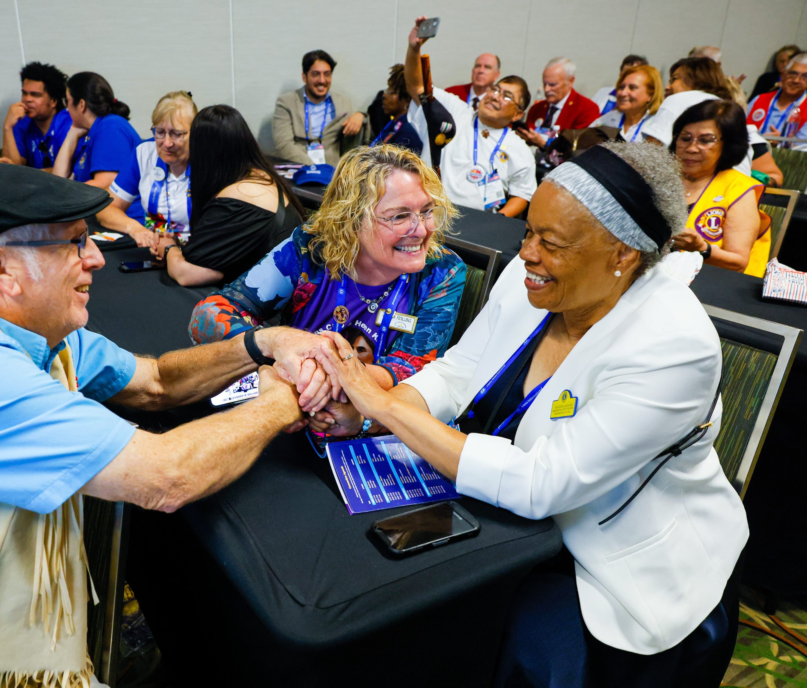
Научи повече с времето
Lions Learning Center
Местни обучения
Подкрепа от клубните лидери
13
13
Notes:
Speaker Notes
“If you’re interested in learning more, there are optional trainings available.
There’s a New Member Orientation course online, and there are also local opportunities if you’re interested later on.
This is something you can explore at your own pace.”

Slide 14


Какво следва
Следваща среща: [Insert]
Предстояща дейност/проект: [Insert]
Лице за контакт: [Insert]
14
Notes:
Speaker Notes
“The most important thing now is your next step.
Whether it’s a meeting or a service project, that’s where you’ll really start to feel connected.”
“Which one would you like to attend first?”

Slide 15
Радваме се, че си тук!
Твоето пътуване започва сега.
15
Notes:
Speaker Notes
“We’re really glad you’re here.
We’re excited to serve with you — and we’re here to support you as you get started.
Any questions before we wrap up?”

